Slide 1
Smart Home System
Amit Graduation project
Presented by: Abdelrahman Sayed, Abdalla Ayman, Mohamed Yasser, and Omar Ehab
Presented to: Amit Learning

Slide 2
Outline
Introduction
Problem definition
Problem solution
Components
Design & Implementation
Flow chart

Slide 3
Introduction
The use of smart home systems would help the humanity to be more secured, as the smart home system is a system where the home setup can be automatically controlled remotely from anywhere with an internet connection or using a mobile

Slide 4
Problem Definition
We want to prove that the use of ARM would help the humanity in a good manner. In addition, create a project that would help anyone to be more secured in their daily life.

Slide 5
Problem Solution
Create a simulated smart home system with the knowledge taken throughout the course duration in AMIT LEARNING facilities. The simulation of the project is done on Proetus with the help of the drivers created with our instructor ENG. ESLAM

Slide 6
Components
The components that was used to create the project are :
Bluetooth module HC05
Relays
Atmega 32A
Servo motor
DC motor
Keypad
Pushbutton
LCD
Buzzer

Slide 7
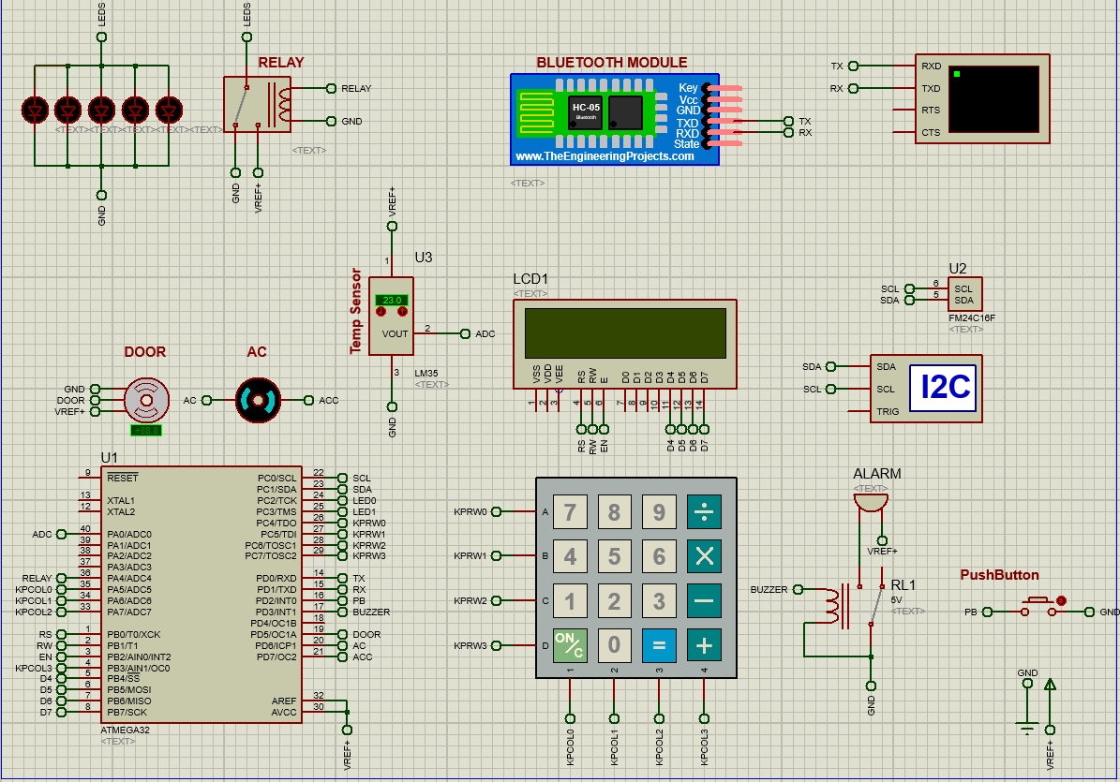
Design & Implementation

Slide 8
Flow Chart
The admin location is at 101, we have used the EEPROM to save the data entry, as the program goes to the desired location and compare the data from the entry array and the EEPROM. In addition, the admin has more additional features, as the admin can add or remove users, control the door, control the relays, and control the AC. However, the user can control only the relays and the AC.

Slide 9
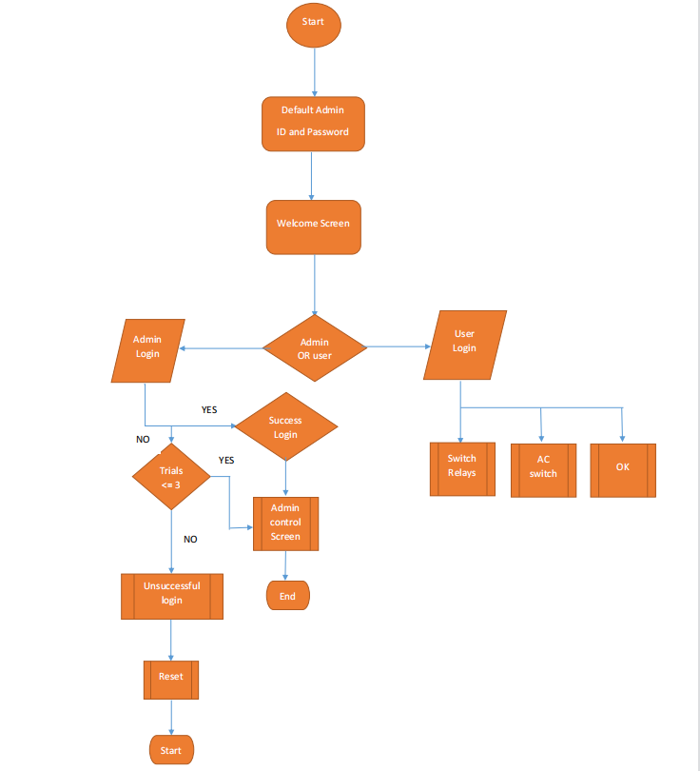
Flow Chart

Slide 10


